Slide 1

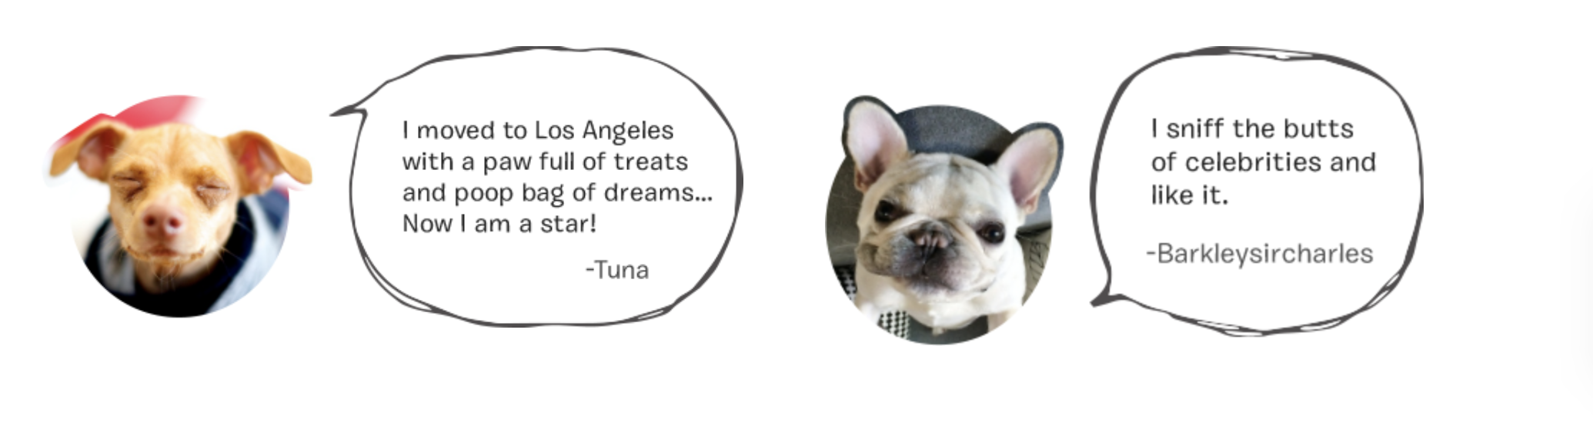
PAWP

Slide 2

About PAWP
The new Instagram for Pets!
Offers a Variety of Products and Services:
Social Media Platform (Post, Share, Comment…)
E-Commerce for your pet
Digital Health Clinic
Blogs and Discussions

Slide 3
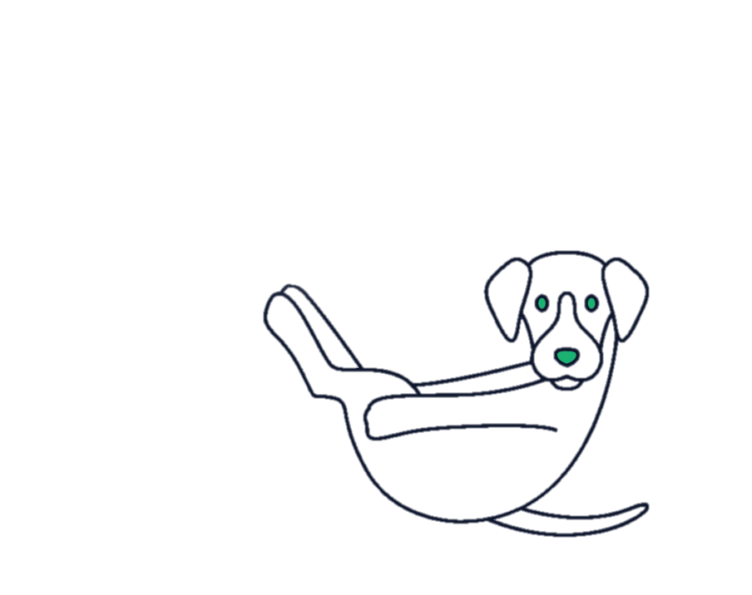
The Problem
We want to classify the type of animal present in a picture in order to better recommend PAWP clients
Our Solution
Database of 25000 pictures of cats and dogs
Running a Convolutional Neural Network (CNN) on those 2 classes
Refine and tune the model to reach our accuracy target
Implement the solution

Slide 4
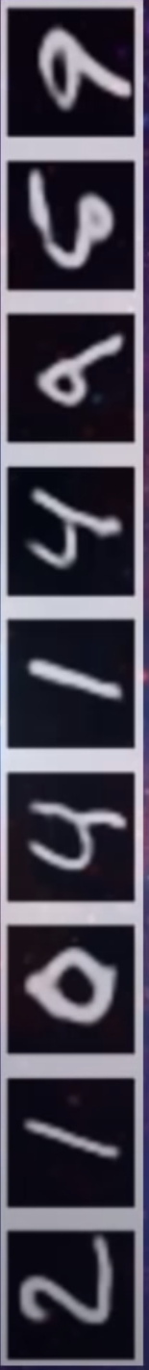
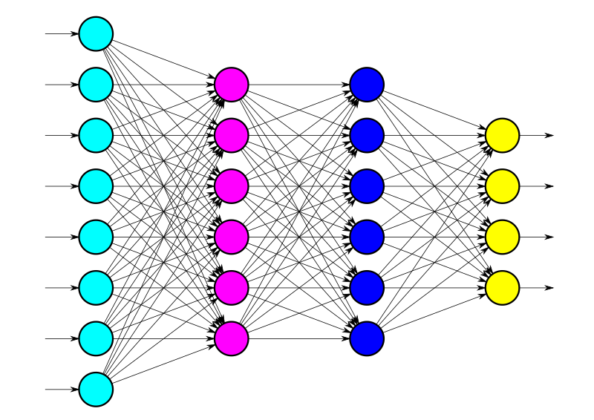
Convolutional Neural Network (1/3)
Image = Matrix of numbers
Convolutional Layer

Slide 5
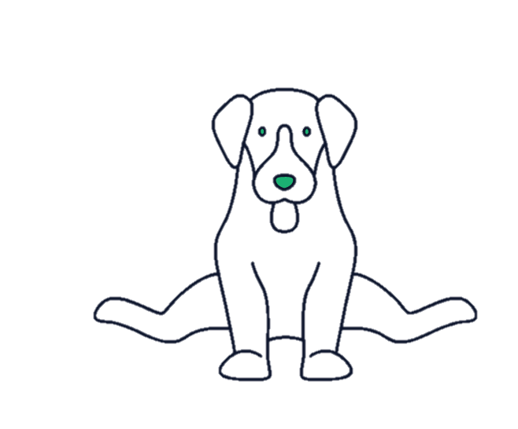
Convolutional Neural Network (2/3)
Convolving

Slide 6
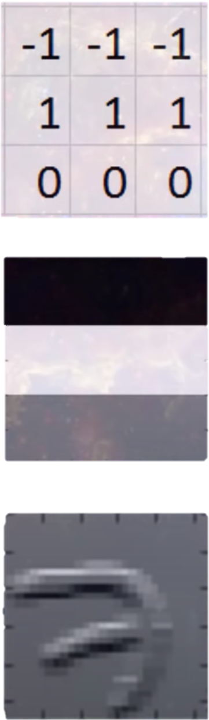
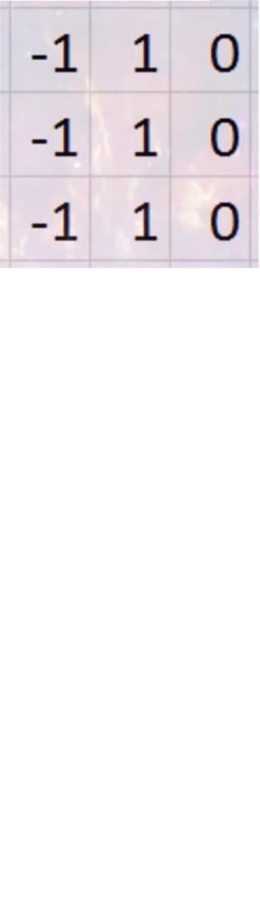
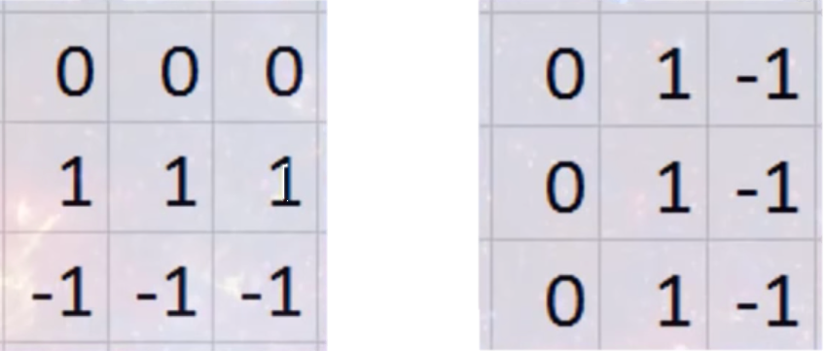
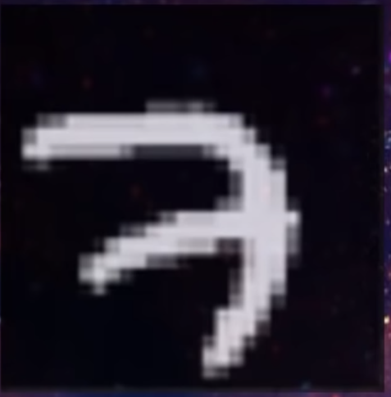

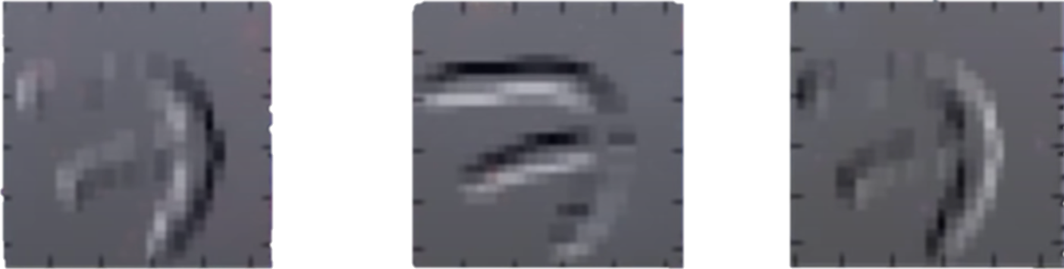
Convolutional Neural Network (3/3)
Top Horizontal Edges
Left Vertical Edges
Bottom Horizontal Edges
Right Vertical Edges

Slide 7
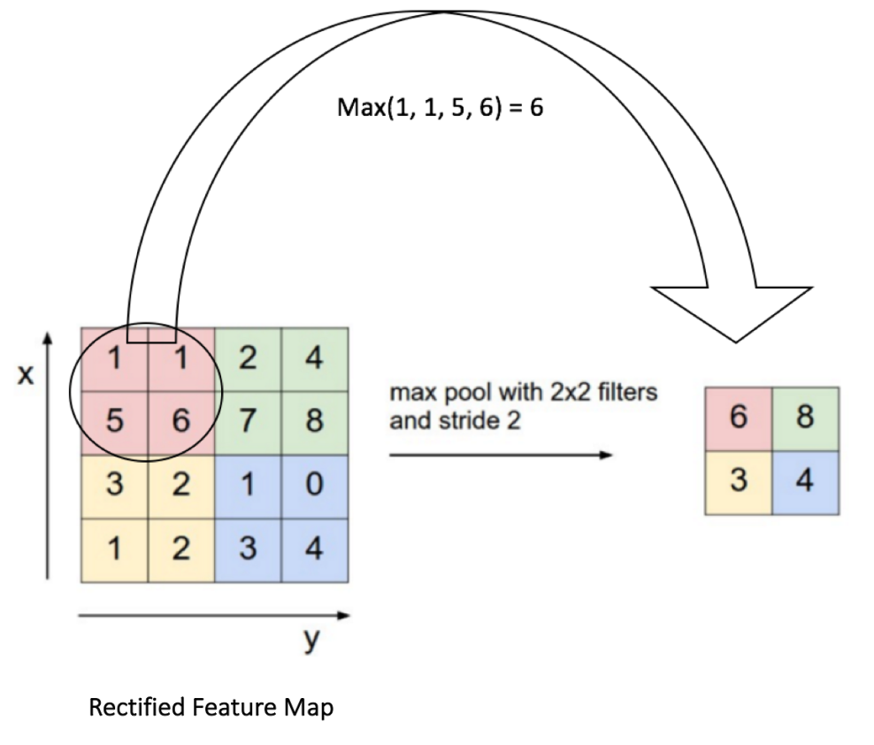
Additional Layers to the Conv2D (1/2)
Max Pooling
Batch Normalization
It does the scaling of the output of the layer:
Faster training of the model
Reduce general errors

Slide 8
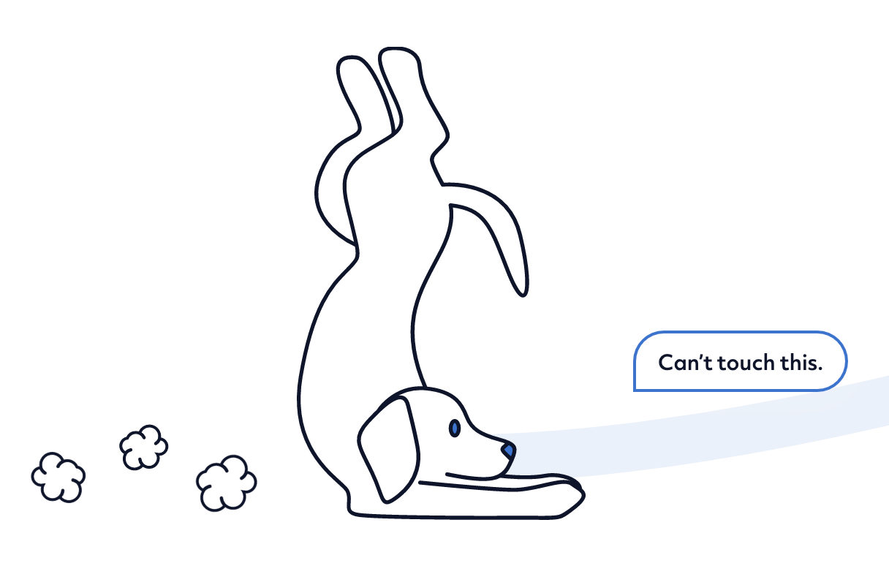
Additional Layers to the Conv2D (2/2)
Dropout Layer
Dense Layer
Regularization technique
Aims to reduce the complexity of the model
Goal is to prevent overfitting
Regularization technique
Aims to reduce the complexity of the model
Goal is to prevent overfitting

Slide 9
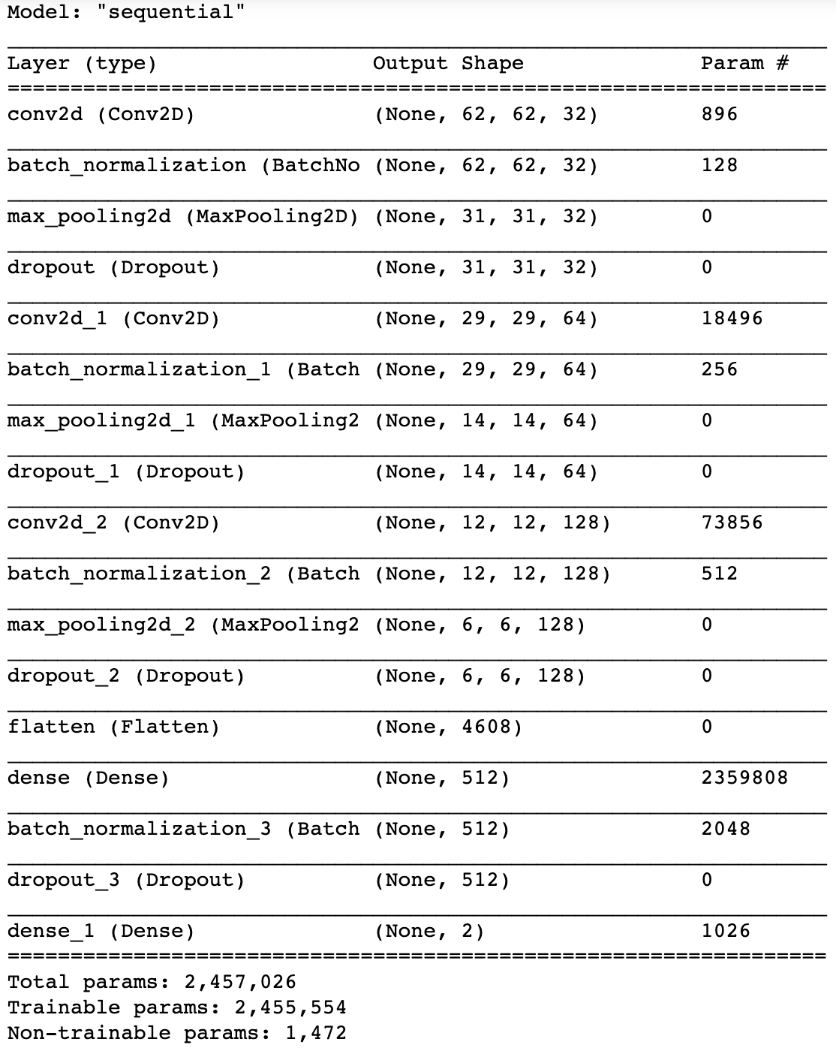
Our Final Model
Includes the following additions:
Conv2d
Batch Normalization
Max Pooling
Dropout
Flatten
Dense

Slide 10
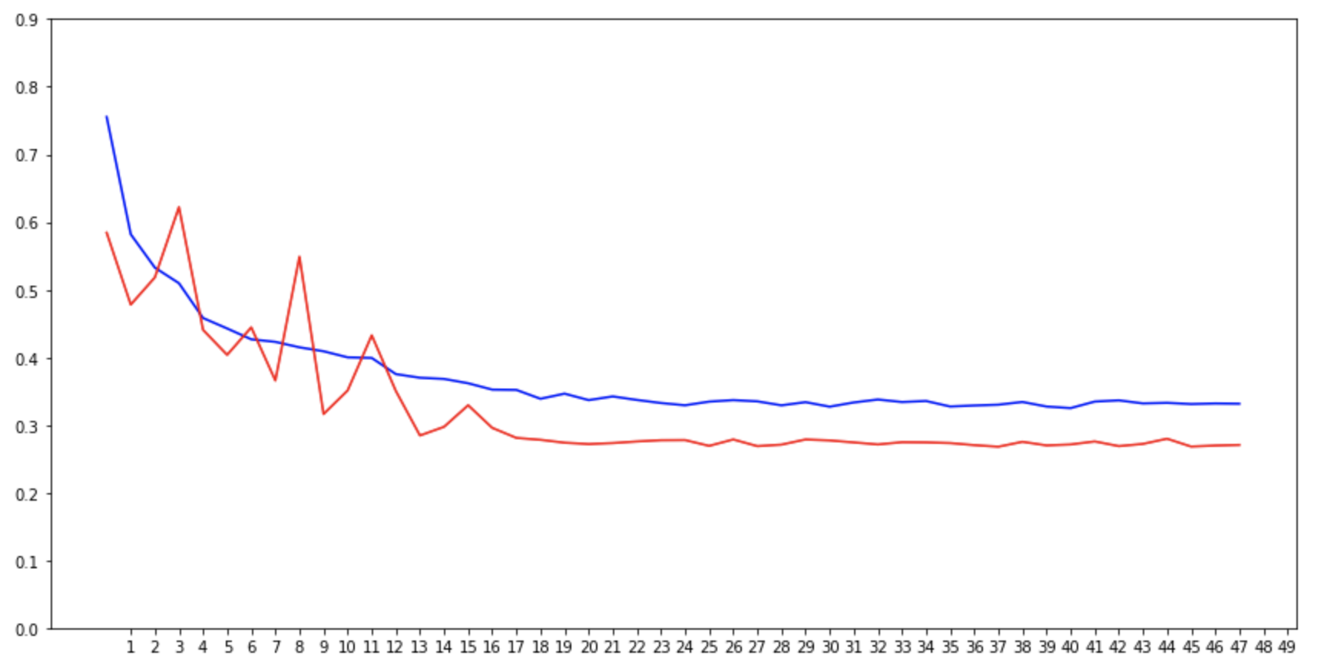
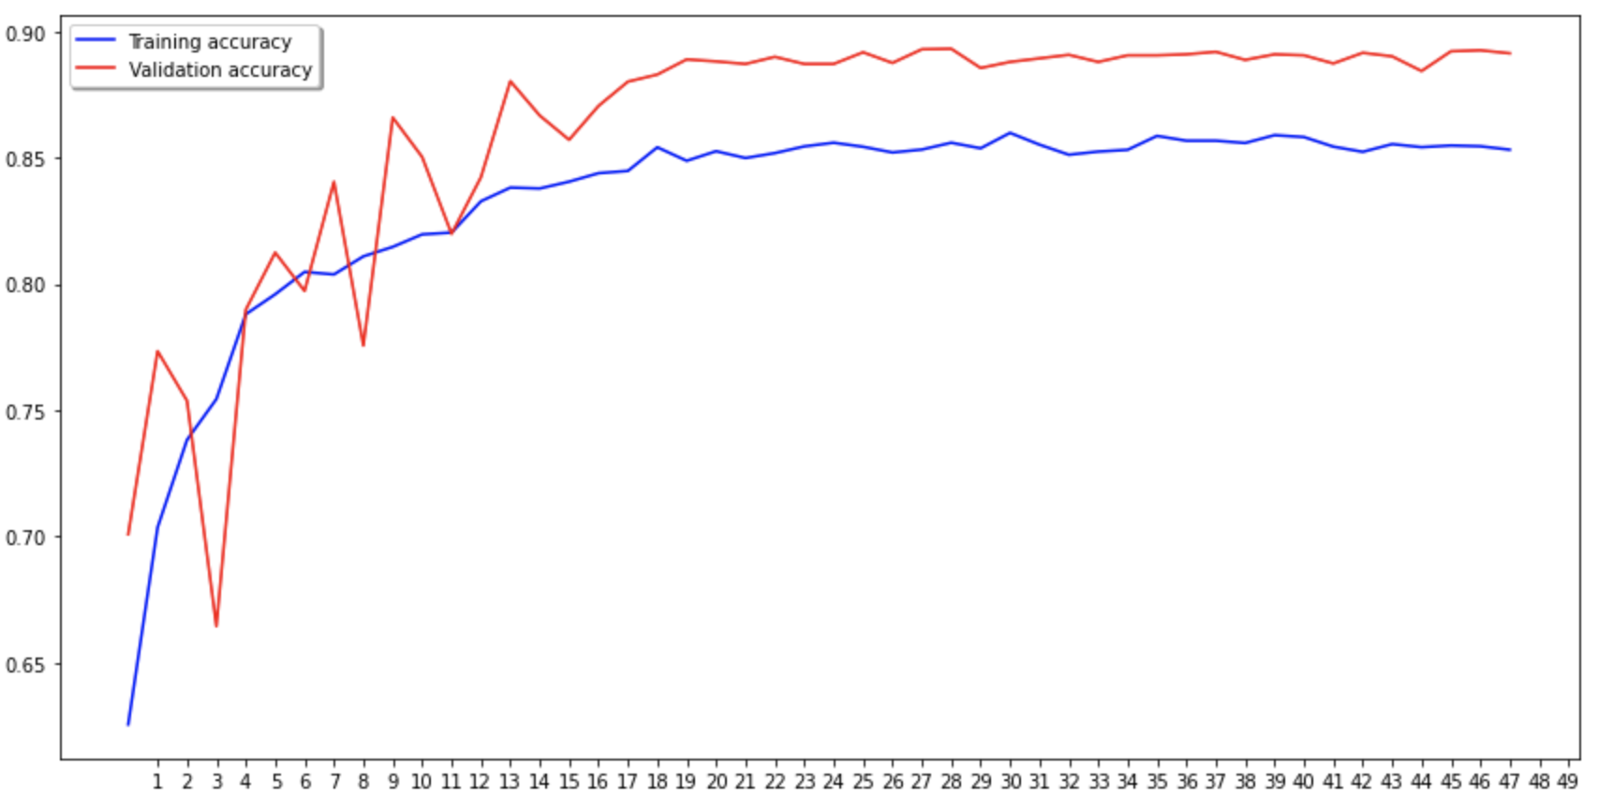
Training Results
Loss
Accuracy

Slide 11
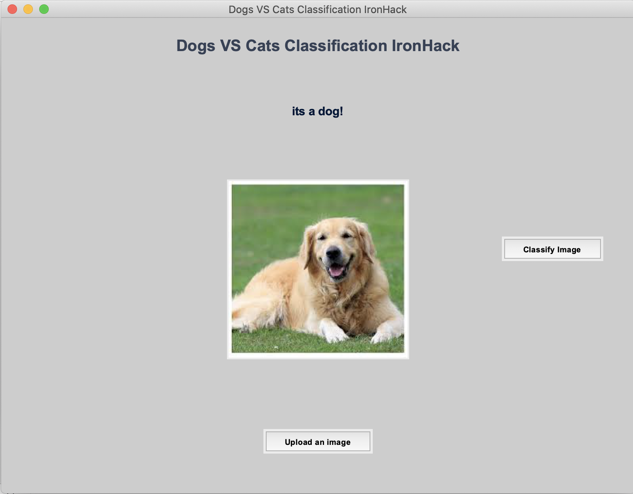
Live Demo

Slide 12
Future Roadmap
Current
Oct 20’
Dec 20’
Mar 21’
Mai 21’
Done
Future Roadmap
Gather 25000 samples
Built a basic model for only 2 classes: Dogs vs Cats
Built the GUI (graphical user interface)
Gather so many more samples and from all the different classes present on the app.
Train a new model with new data and keep refining
Implementation and deployment in the source code( by Mai 2021)

Slide 13
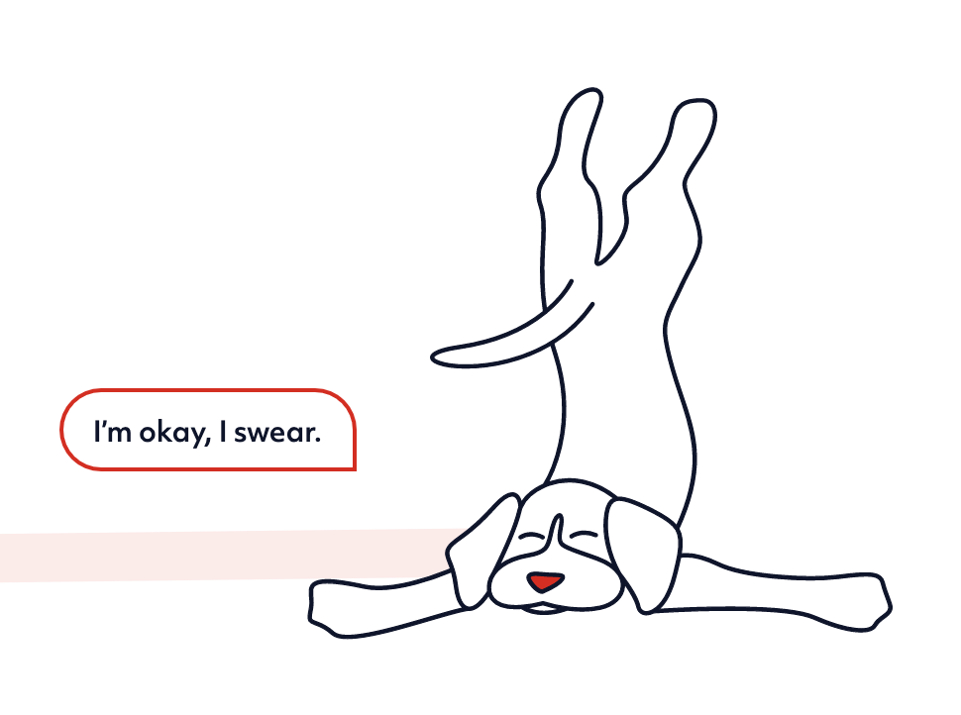
Thank You!

